Slide 1
Lesson 3: Activities
COMP3025

Slide 2
Agenda
Assignment 1b
Learn about wireframes – makers night
The Activity Lifecycle
Building a tip calculator

Slide 3
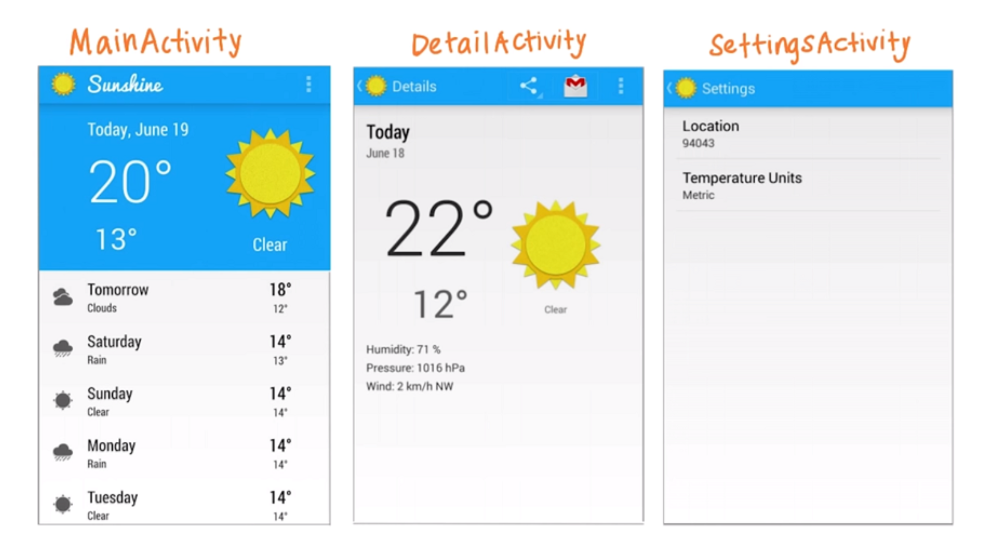

What is an activity?

Slide 4
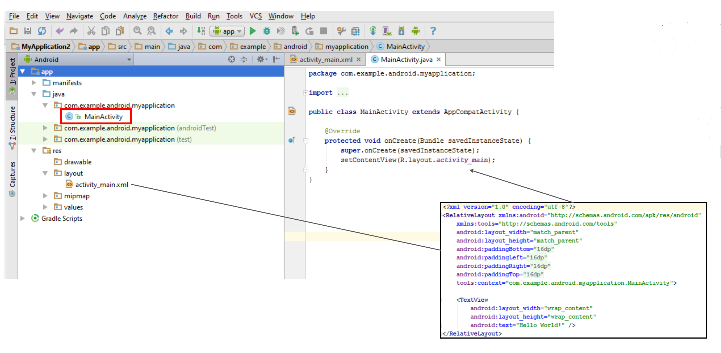
What is an activity?

Slide 5
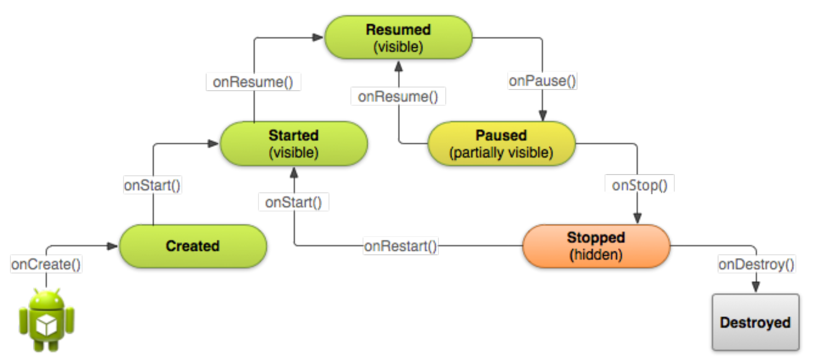
The activity lifecycle

Slide 6
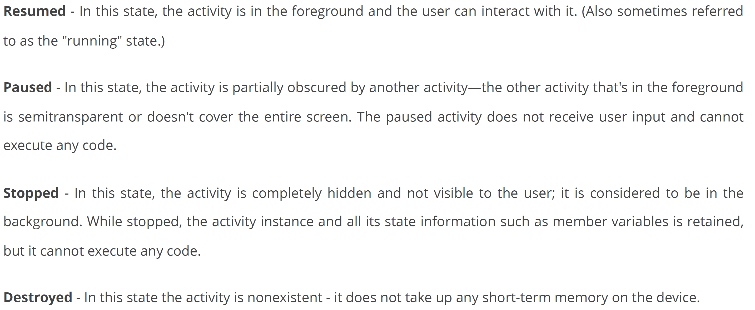
The 4 activity states

Slide 7
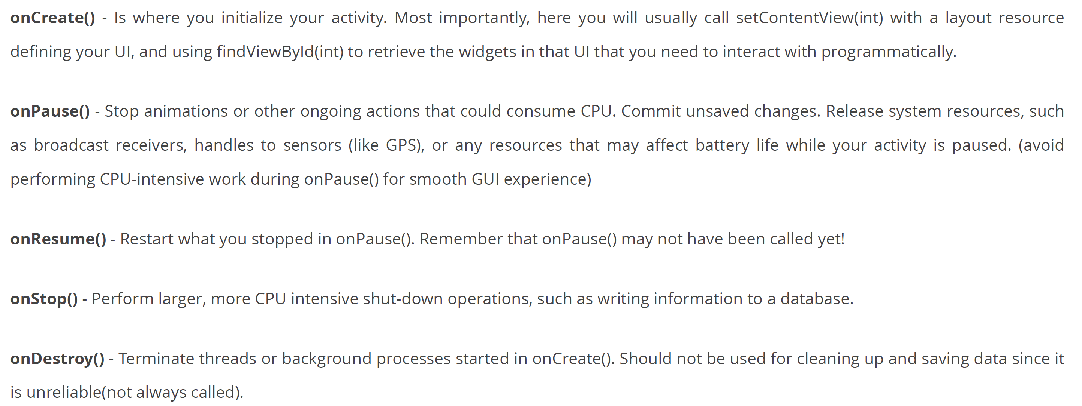
Which method to use?

Slide 8
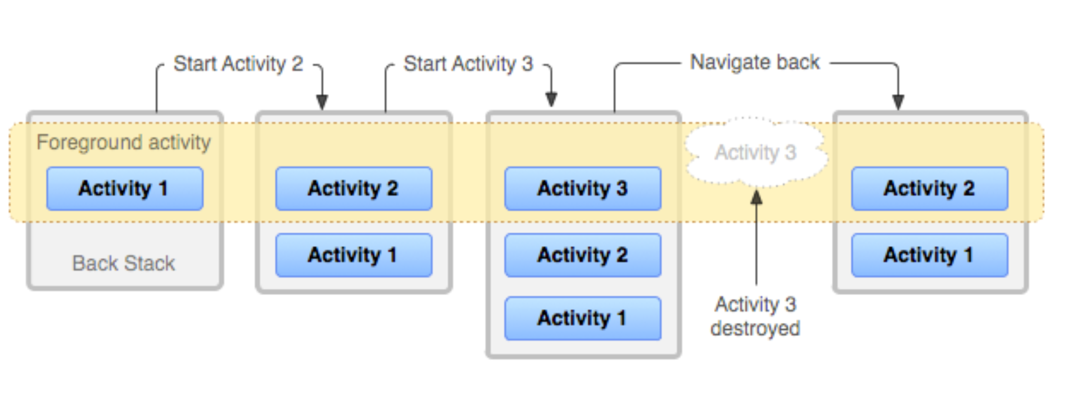
The back stack

Slide 9
Activity state
Your activity is destroyed when:
You programmatically call finish()
User presses the back button
Your activity is destroyed and recreated if:
User rotates the device
User changes language
The application is terminated by the system to regain RAM
The saved data that the system uses to restore the previous state is called the "instance state" and is a collection of key-value pairs stored in a Bundle object.
By default, the system uses the Bundle instance state to save information about each View object in your activity layout (such as the text value entered into an EditText object). So, if your activity instance is destroyed and recreated, the state of the layout is restored to its previous state with no code required by you.

Slide 10
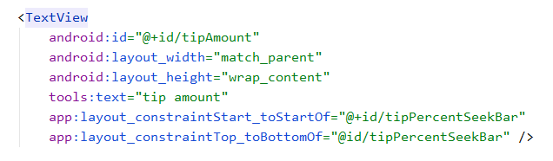
Layout.xml
android: programming
match_parent - make the view object as big as the container holding it
tools: only visible in the designer
wrap_content - make the view object as big as the elements inside
app: layout (what user see’s)

Slide 11
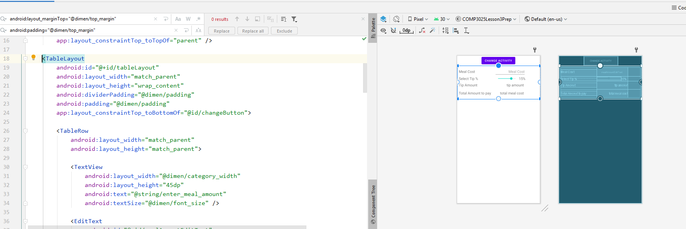
Table Layout

